Slide 1

Topic: Intro to Operating Systems
Lecture: Dr. Zhao Jie
Date: 01/14/2026

Slide 2
Reading Assignment
Reading Assignment: Ch. 2

Slide 3
Agenda
OS Definition
How to Run a Program on a Computer
OS Management

Slide 4
What is an operating system?[1]
Definition
Middleware between user programs and system hardware
Role(Q: What are five basic components of a computer?)
Manage both software and hardware components, including CPU, memory, secondary data storage, and I/O devices.
Implementation (Q: to understand a function call, give a C program example, and ask for outputs.)
Use system calls, which are simple function calls but have notable differences.
[1]. https://www.cse.iitb.ac.in/~mythili/os/anno_slides/lecture1.pdf

Slide 5
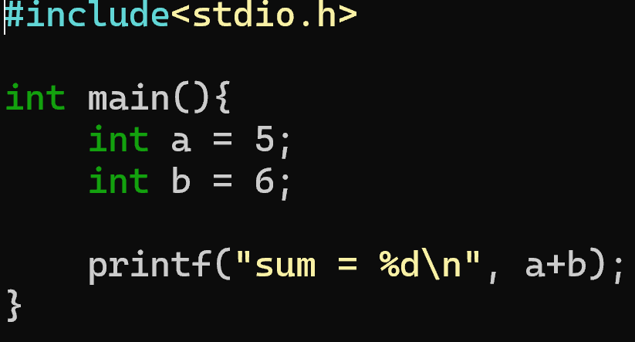
High-level and low-level programming languages
A C program is one type of high-level programming language, written by a programmer, with the feature of human readability.
The computer can understand not the C program, but machine language, which is a series of binary digits.
Faced with high-level and low-level programming languages, a compiler is necessary to translate high-level programs into the low-level one, so-called executable(“.c” to “a.out”)

Slide 6
Machine language and instruction sets
An instruction set is the dictionary of commands a CPU can understand, like a list of all possible verbs and numbers, while machine language is an actual program, a sequence of binary 0s and 1s that uses those commands to perform a specific task.
In essence, the instruction set defines what operations are possible (e.g., "add," "load"), and machine language is the specific, executable binary code that uses those definitions to tell the processor what to do.

Slide 7
What happens when you run a program?-1[1]
A compiler translates high-level programs into an executable(“.c” to “a.out”)
The exe contains instructions that the CPU can understand the commands and data of the program(all numbered with addresses)
Instructions run on CPU: hardware implements an Instruction Set Architecture (ISA)
CPU also consists of a few registers, e.g.,
--- Pointer to current instruction (program counter or PC)
--- Operands of instructions, memory addresses
[1]. https://www.cse.iitb.ac.in/~mythili/os/anno_slides/lecture1.pdf

Slide 8
What happens when you run a program?-2 [1]
To run an exe, CPU will
--- fetches instruction pointed at by PC from memory
--- Decodes and loads data required by the instructions into registers
--- Executes the instruction
--- stores results in memory(optional)
Most recently used instructions and data are saved in CPU caches for faster access
[1]. https://www.cse.iitb.ac.in/~mythili/os/anno_slides/lecture1.pdf

Slide 9
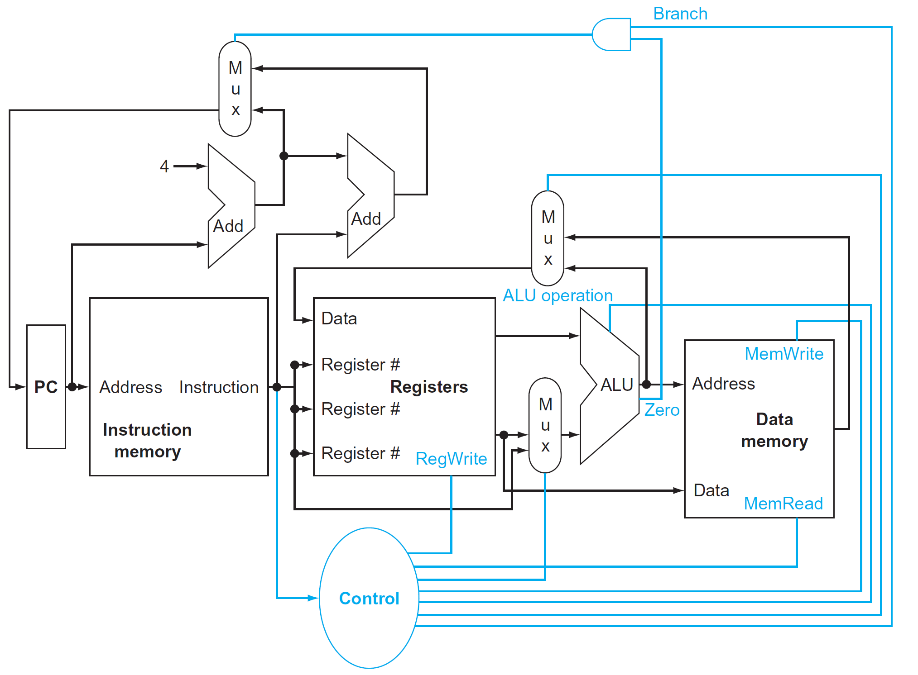
So, what happens when you run a program? -3 [2]
[2]. David A. Patterson, “Computer Organization and Design RISC-V Edition: The Hardware Software Interface”
Notes:
The diagram has four devices: reg, mem, mux, and ALU. Mux is a selector with N inputs and one output. How does an instruction run and execute? Step One: The PC fetches an instruction. Step Two’s instruction is decoded, and the data from memory. In step three, the instruction is executed in the ALU.

Slide 10
So, what does the OS do?[1]
OS manages program memory
--- Loads program executable(code, data) from disk to memory
OS manages CPU
--- initializes program counter (PC) and other registers to begin execution
OS manages external devices
--- Read/write files from disk.
[1]. https://www.cse.iitb.ac.in/~mythili/os/anno_slides/lecture1.pdf

Slide 11
OS manages CPU [1]
OS provides the process abstraction
--- Process: a running program
--- OS creates and manages processes
Each process has the illusion of having the complete CPU, i.e., OS virtualizes CPU
Timeshares CPU between processes
Enables coordination between processes
[1]. https://www.cse.iitb.ac.in/~mythili/os/anno_slides/lecture1.pdf

Slide 12
OS manages memory [1]
OS provides the memory of the process: code, data, stack, heap etc
Each process thinks it has an isolated memory space for itself, numbers code, and data starting from 0 (virtual addresses)
OS abstracts out the details of the actual placement in memory, translates from virtual addresses to actual physical addresses
[1]. https://www.cse.iitb.ac.in/~mythili/os/anno_slides/lecture1.pdf

Slide 13
OS manages devices [1]
OS has code to manage disk, network card, and other external devices: device drivers
Device driver talks the language of the hardware devices
--- Issues instructions to devices (fetch data from a file)
--- Responds to interrupt events from devices (user has pressed a key on the keyboard)
Persistent data organized as a filesystem on disk
[1]. https://www.cse.iitb.ac.in/~mythili/os/anno_slides/lecture1.pdf

Slide 14
Design goals of an operating system [1]
Convenience, abstraction of hardware resources for user programs
Efficiency of usage of CPU, memory, etc
Isolation between multiple processes
[1]. https://www.cse.iitb.ac.in/~mythili/os/anno_slides/lecture1.pdf

Slide 15
History of operating systems [1]
Started out as a library to provide common functionality across programs
Later, evolved from procedure call to system call
When a system call is made to run OS code, the CPU executes at a higher privilege level
Evolved from running a single program to multiple processes concurrently
[1]. https://www.cse.iitb.ac.in/~mythili/os/anno_slides/lecture1.pdf

